Slide 1
Credit Card Holder Risk
Venkateswararao Para, David Huang, Yash Abhyankar, Shraddha Waphare
Notes:
Approximately 7 minutes to present everything

Slide 2
Statement of Problem
Determine the risks and analyze the spending habits of credit card holders
Suggestions of financial management to reduce risk of overspending
Credit card companies gives credit cards out with varying traits
Spending limit, interest rates, rewards and benefits
Example
Clustering on high spending limit and minimum payments
Produce groups of high risk and low risk
https://www.kaggle.com/datasets/jillanisofttech/market-segmentation-in-insurance-unsupervised
Notes:
Problem: Determine risk and analyze spending habits of credit card holders
Once we have that, we can suggest financial management to reduce the risk of credit spending because credit card companies give different varying traits which with some people who dont have any financial literacy, would fall into debt very quickly.
An example that would provide would be clistering on high spending limit and minimum payments: which would produce a who have very high spending limits and do a little minimum payment would be a risk factor
Briefly touch over Kaggle dataset

Slide 3
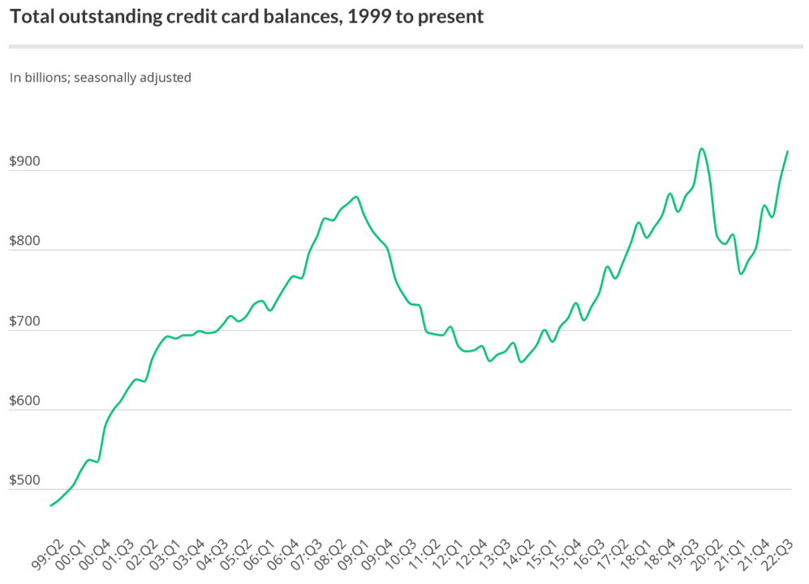
Why is it important?
Increasing credit card debt
Increasing interest rates in the US
Increasing inflation
Seasonal shopping
Improve financial awareness
Notes:
To prevent people from falling into debt and going under credit card debt and not coming back. Credit score is very important in the US because it helps determine loans rates, mortgage rates and being a low credit risk is very helpful for making big decisions.

Slide 4
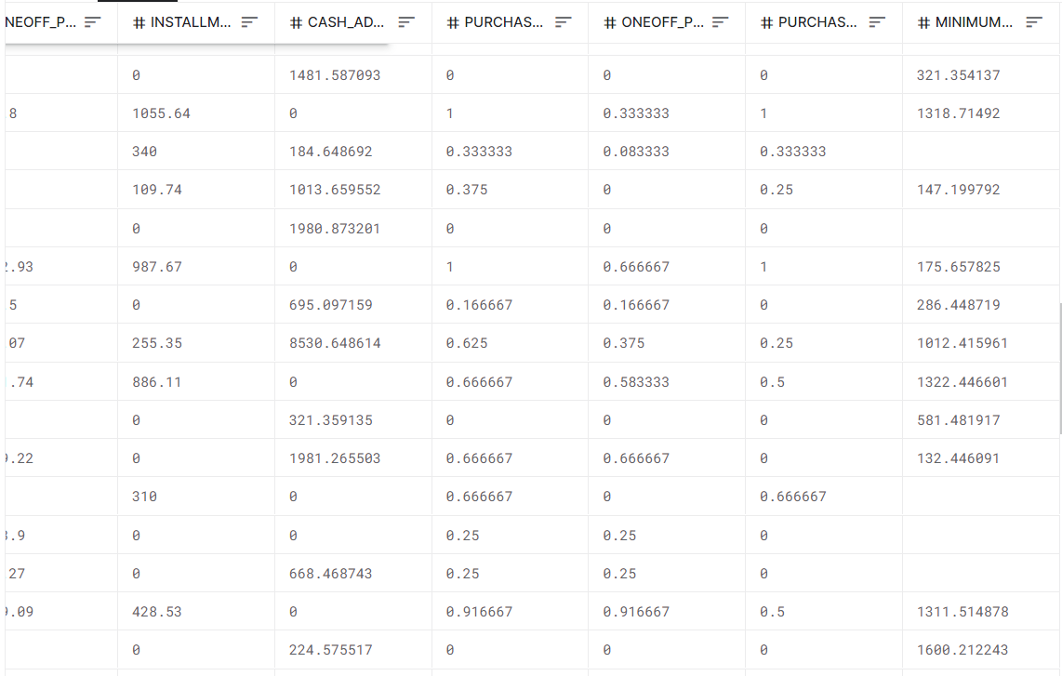
Methods
Exploratory Data Analysis
Handling NA entries
Removing ID columns
Formatting information
Principal Component Analysis
K-Means Clustering
Density Based Modeling
Distribution Based Modeling

Slide 5
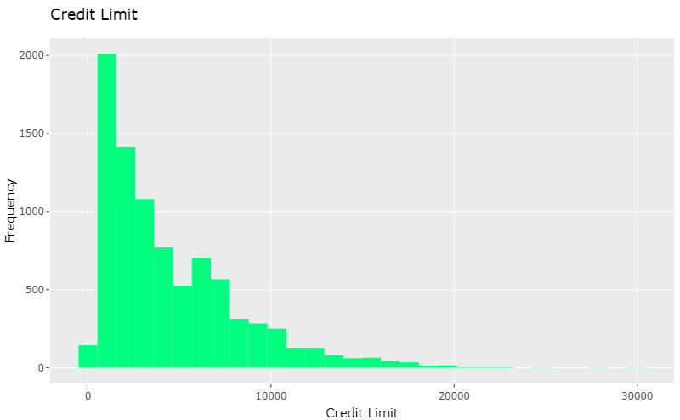
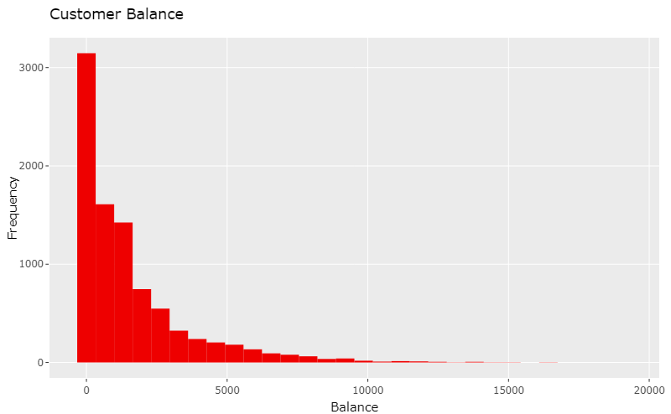
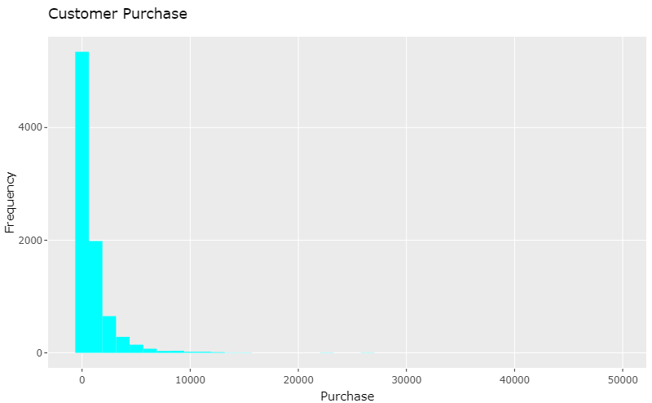
EDA on the features

Slide 6
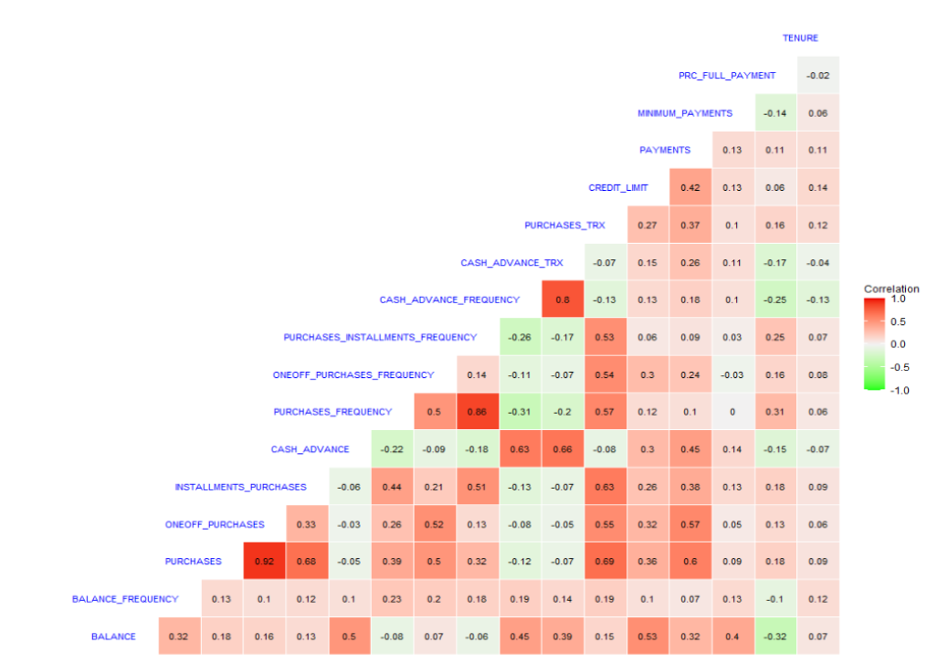
Results: Correlation Plot

Slide 7
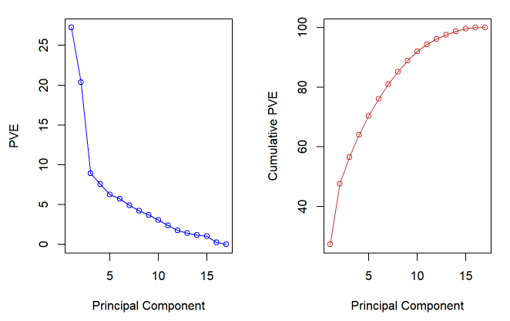
Results: Principal Component Analysis

Slide 8
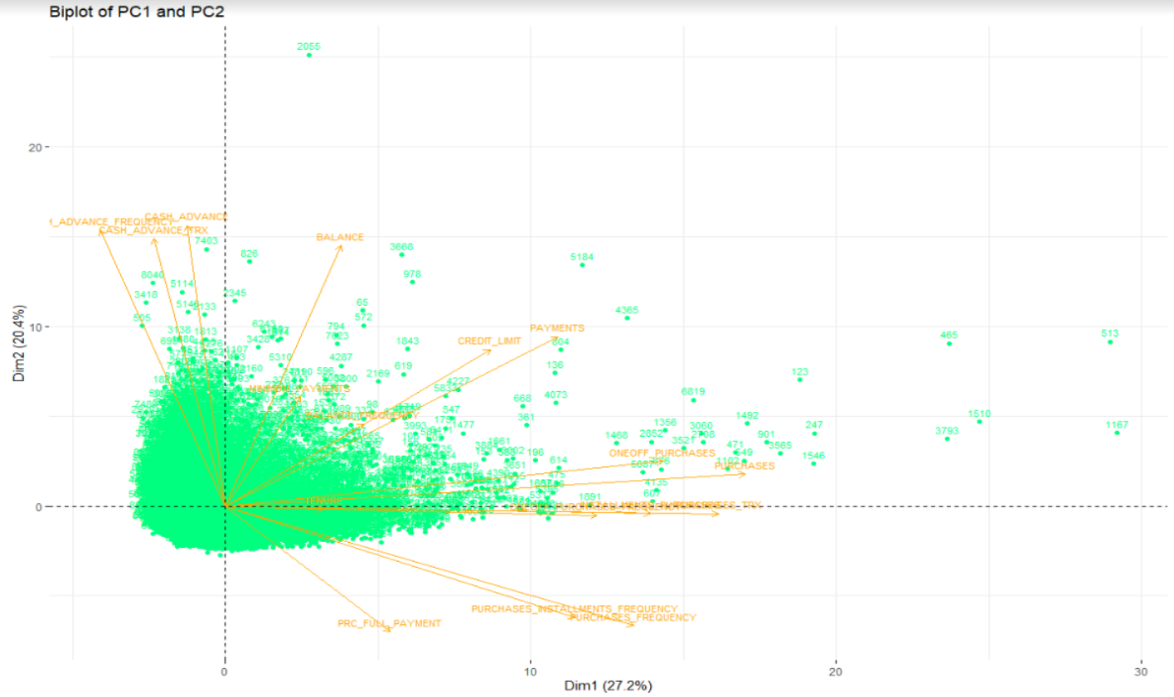
Results: Biplot of Principal Components

Slide 9
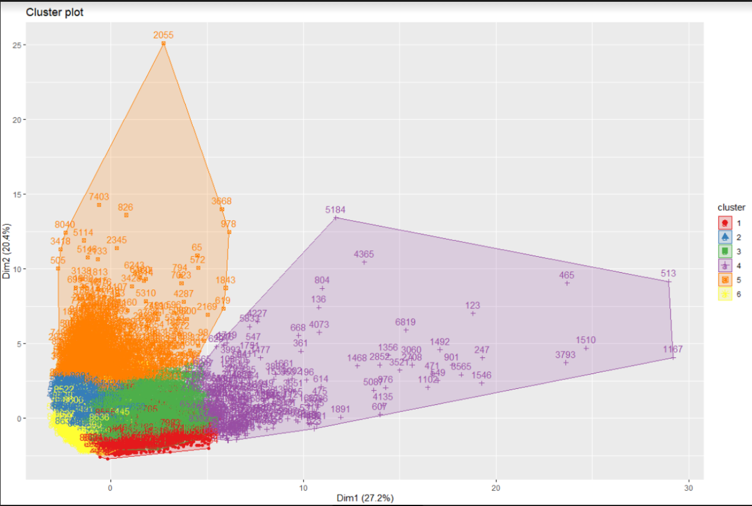
Results: K-Means Clustering

Slide 10
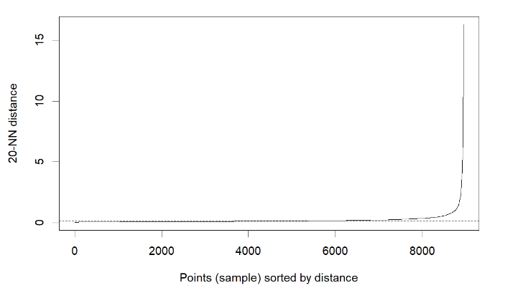
Results: Density Based Modeling
Based on the minimum points and epsilon, the number of clusters are decided

Slide 11
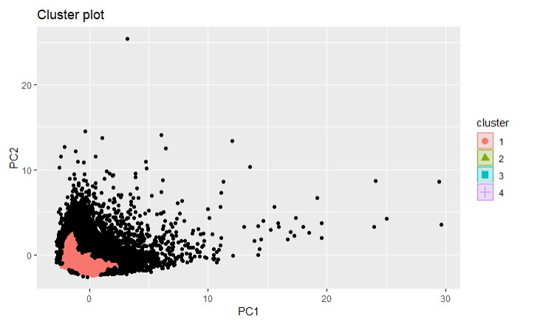
Results: Density Based Modeling

Slide 12
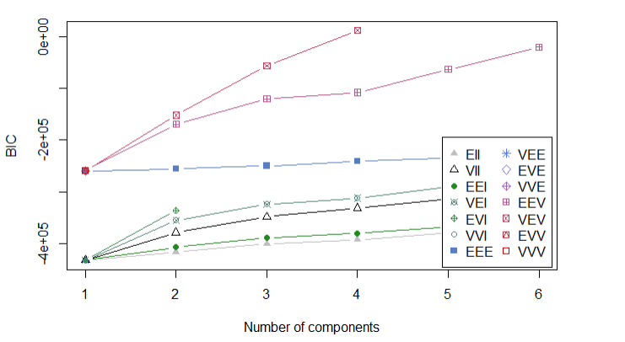
Results: Distribution Based Modeling
BIC (Bayesian Information Criterion) Value
To identify the precise model
To find the number of cluster

Slide 13
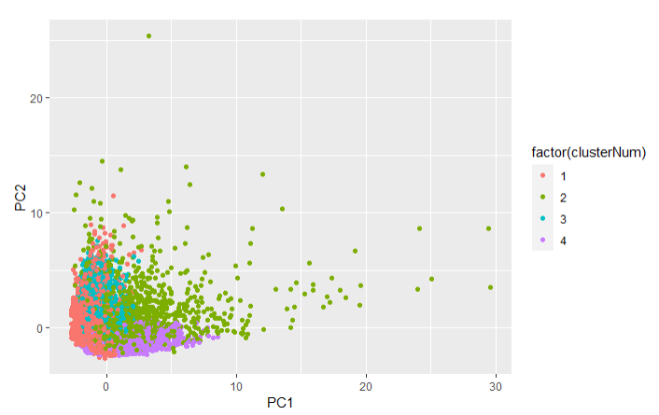
Results: Distribution Based Modeling

Slide 14
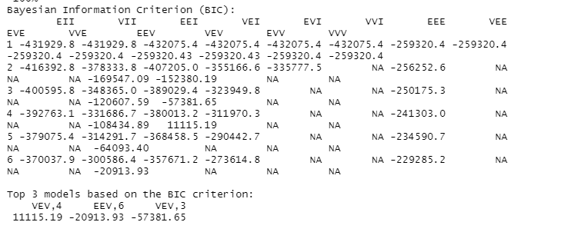
Results: Distribution Based Modeling

Slide 15
Conclusions
Strong influence from first 3 Principal Components
6 clusters obtained segmenting the credit card users based on the spending behaviour

Slide 16
References
https://www.lendingtree.com/credit-cards/credit-card-debt-statistics/

